Slide 1

Climate change and its effects
Data Kings:
Sai Kumar Kothuru
Surya Teja Gadde
Rahul Reddy Bakkannagari
Nikhil Gande

Slide 2

Agenda
Introduction
Problem statement and background
Data Preprocessing and Analysis
Model Evaluation
Results
Conclusion
Climate change and its effects

Slide 3
Introduction
Our aim is to analyses the effects of climate change by observing global temperatures and comparing temperature variations among different countries and cities. Climate change is a topic of major concern worldwide as it impacts various aspects of life, including agriculture, water resources, health, and infrastructure.
Therefore, it is essential to analyze the impact of climate change and develop strategies to mitigate its effects .In this project, we have used climate data to evaluate the effect of climate change on earth's surface temperature. The dataset used in this study is Climate Change: Earth Surface Temperature Data.
In this project, we cover the data preprocessing, analysis, and visualization steps. Furthermore, different machine learning models are employed to predict and evaluate temperature trends
Climate change and its effects
20XX

Slide 4
Problem statement and background
The dataset used in this project is Climate Change: Earth Surface Temperature Data, which provides temperature data from the year 1750 to 2015. We have used the dataset to analyze the trend in temperature change and explore the countries that have been most affected by climate change.
The project aims to explore different machine learning models to predict temperature changes and evaluate their performance
Climate change and its effects

Slide 5
Data Preprocessing and Analysis
The dataset is loaded into three separate DataFrames, representing global temperatures, temperatures by major city, and temperatures by country. The data is then cleaned by removing rows containing missing values, and necessary columns are extracted for further analysis. The data is analyzed to determine the average, minimum, and maximum temperatures for each major city.
Climate change and its effects

Slide 6
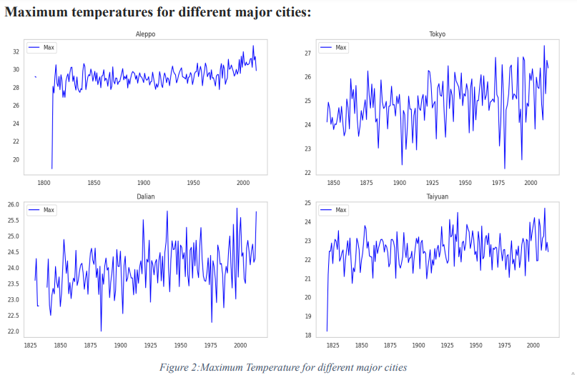
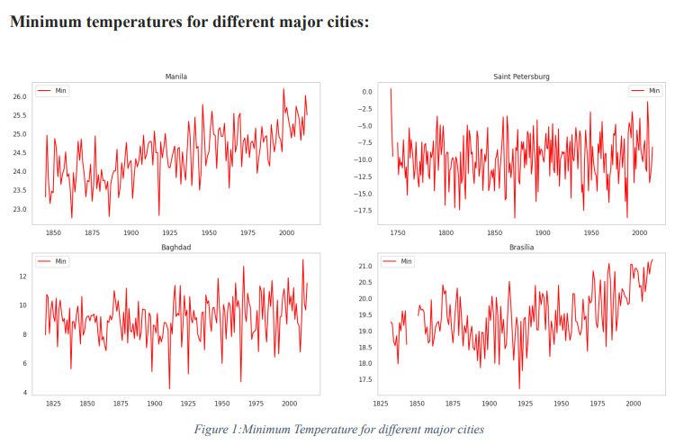
Data Preprocessing and Analysis
The data is analyzed to determine the average, minimum, and maximum temperatures for each major city.
Climate change and its effects

Slide 7
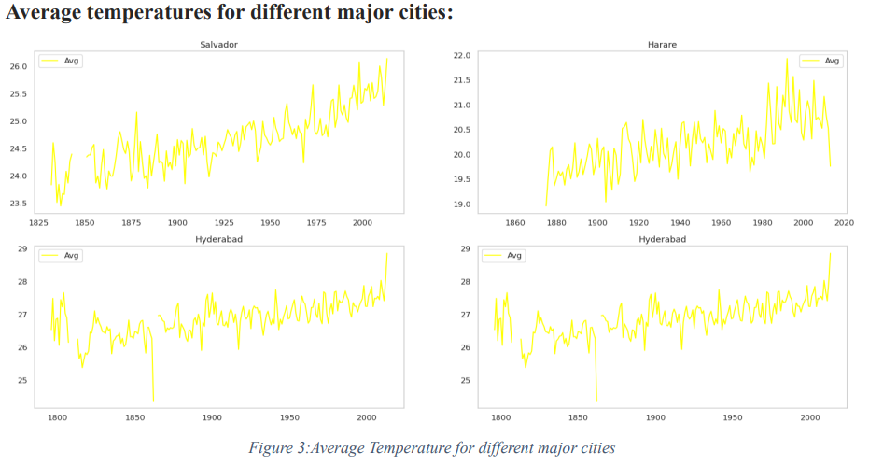
Data Preprocessing and Analysis
The data is analyzed to determine the average, temperatures for each major city.

Slide 8
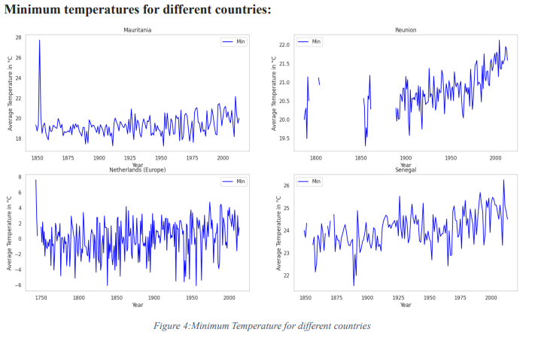
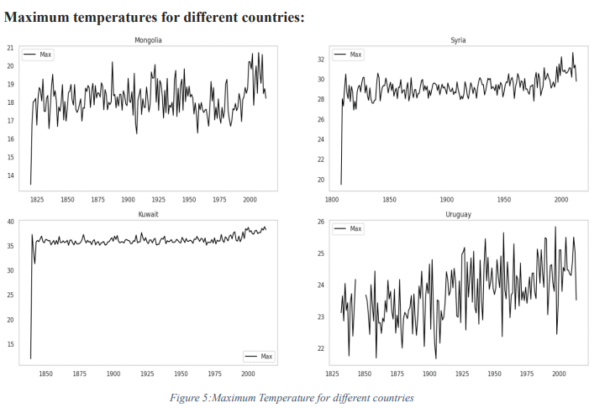
Data Preprocessing and Analysis
The data is analyzed to determine the minimum, and maximum temperatures for each country.

Slide 9
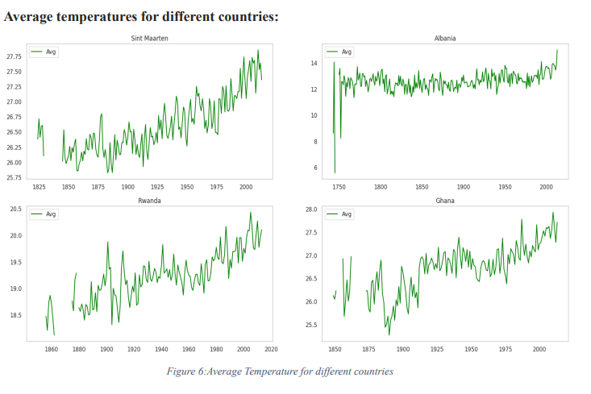
Data Preprocessing and Analysis
The data is analyzed to determine the average temperatures for each country.

Slide 10
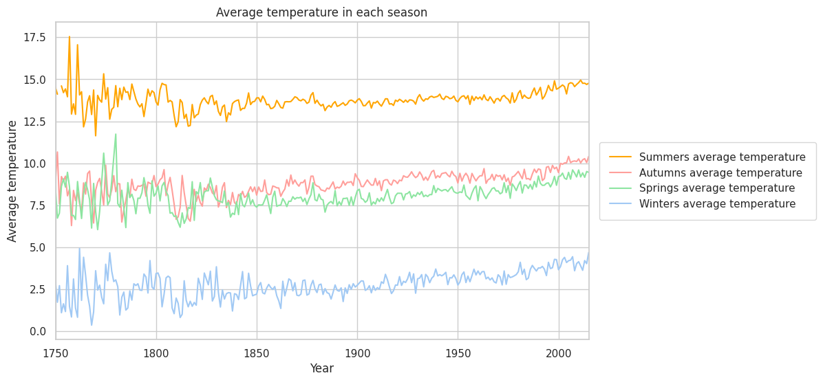
Seasonal Change

Slide 11
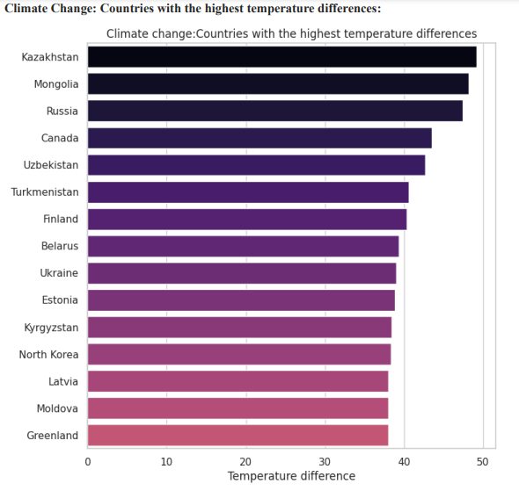
Data Preprocessing and Analysis
Additionally, the countries with the highest temperature differences are identified by calculating the difference between the maximum and minimum temperatures recorded for each country. The top 15 countries with the highest temperature differences are plotted using a bar chart.

Slide 12
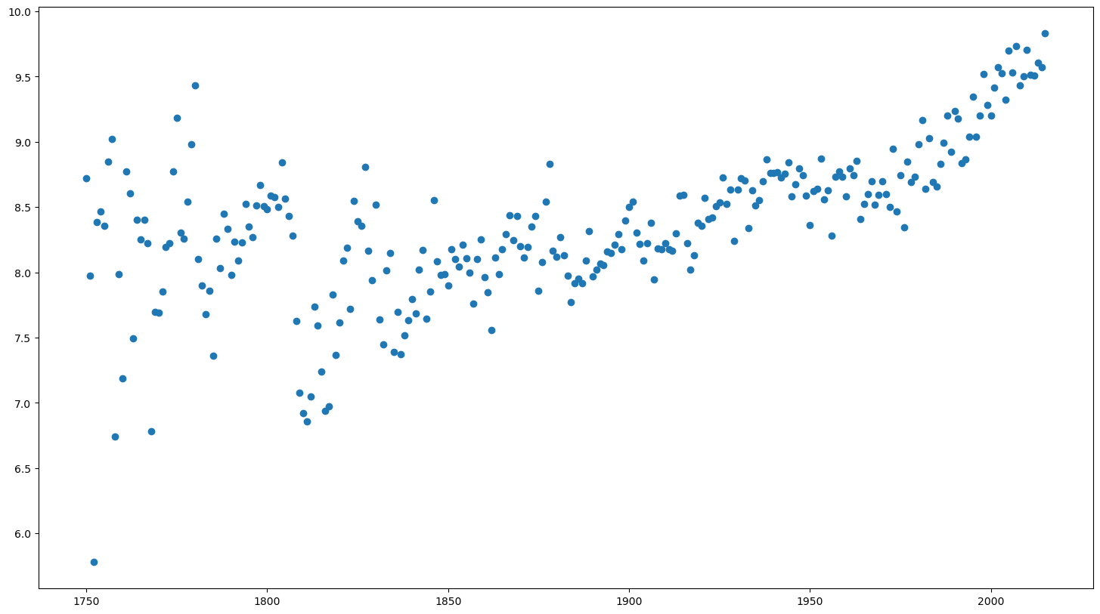
OVERALL TREND

Slide 13
Model Evaluation
Linear Regression: Linear Regression is used to fit the line for the temperature prediction.
Support Vector Regression: Support Vector Regression is used to determine a hyperplane for the prediction of the temperature

Slide 14
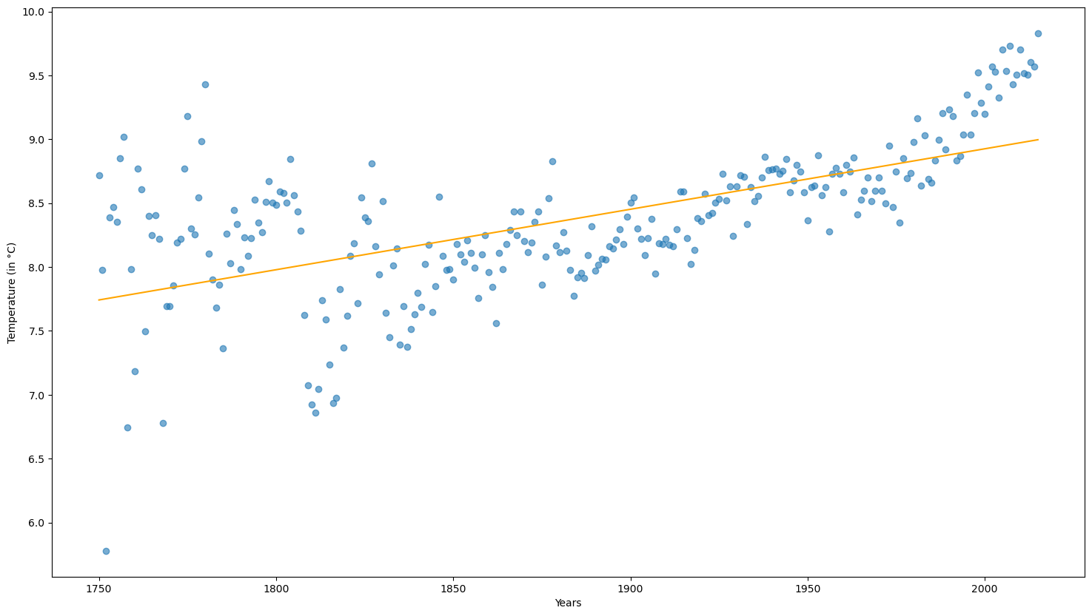
Linear Regression

Slide 15
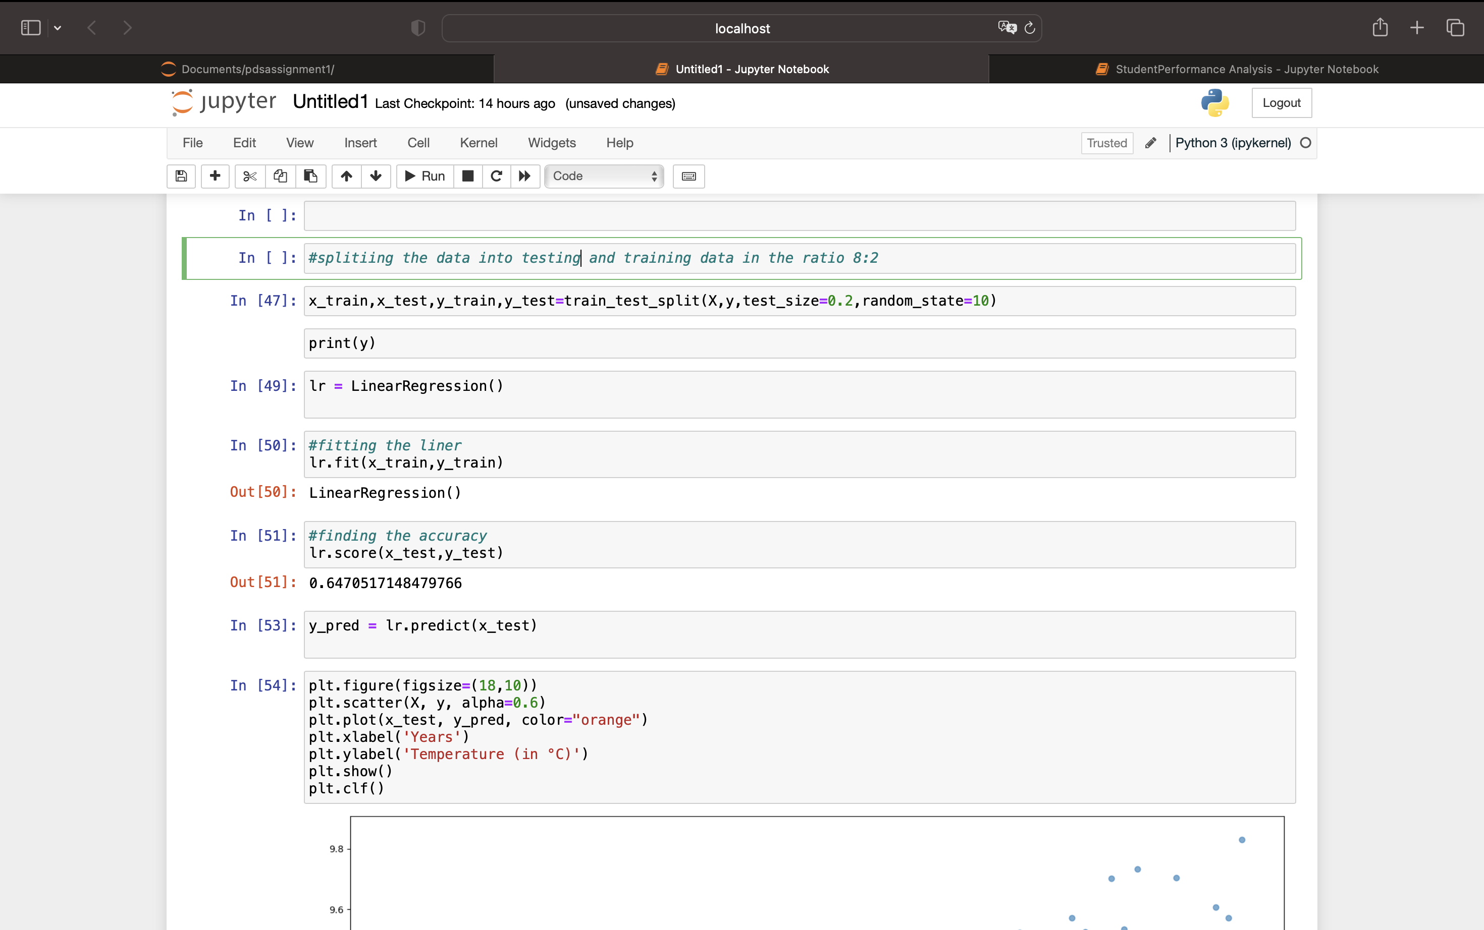
RESULT

Slide 16
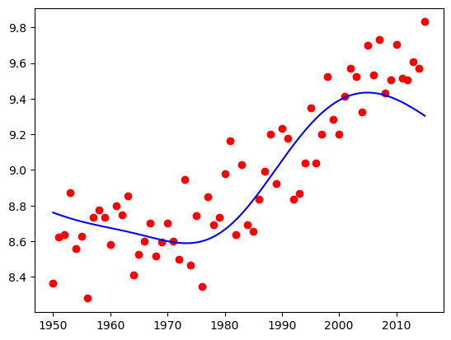
SUPPORT VECTOR REGRESSION

Slide 17
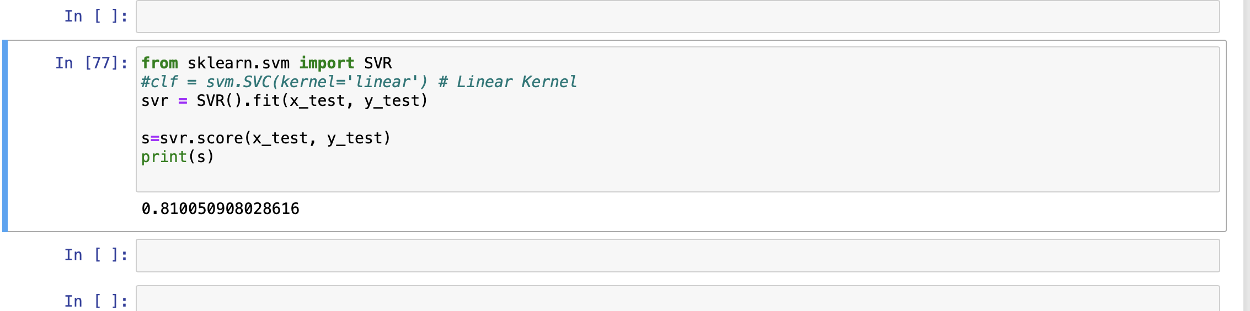
SVR RESULT

Slide 18
Results
Climate Change: GlobalLandTemperaturesByCountry using Average Temperature
The SVR model performed well, with an accuracy of 80.%. The Linear Regression model also performed well, with an accuracy of 64%.

Slide 19
Conclusion
The analysis of global temperature data reveals that temperature trends vary significantly among countries and cities. The machine learning models employed in this study have shown varying levels of success in predicting temperature trends, with SVR models achieving the highest accuracy.
In conclusion, this project highlights the importance of analyzing climate change and developing strategies to mitigate its effects. The machine learning models used in this project can help predict future temperature changes and aid in developing strategies to combat climate change.

Slide 20
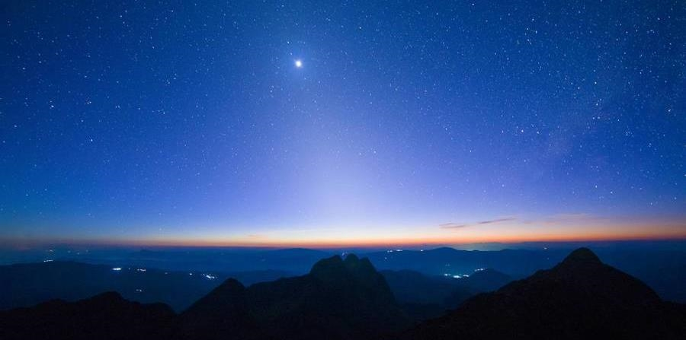

Thank you
20XX

